Slide 1
Applying for Starting and Team Grants in 2023
Helen Post
Head of the Field of National Research Grants
7 March 2023

Slide 2
Call 2023
starting grants (PSG, up to 5 years)
team grants (PRG, up to 5 years)
Submission of applications via ETIS from 1 to 31 March at 5 p.m. (Estonian time).
NB! The application is submitted only after the applicant’s institution has confirmed it via ETIS. Please follow the deadlines of your institution (University of Tartu 23 March, TalTech 20 March)!
NB! Read the materials on the website of the Council!

Slide 3
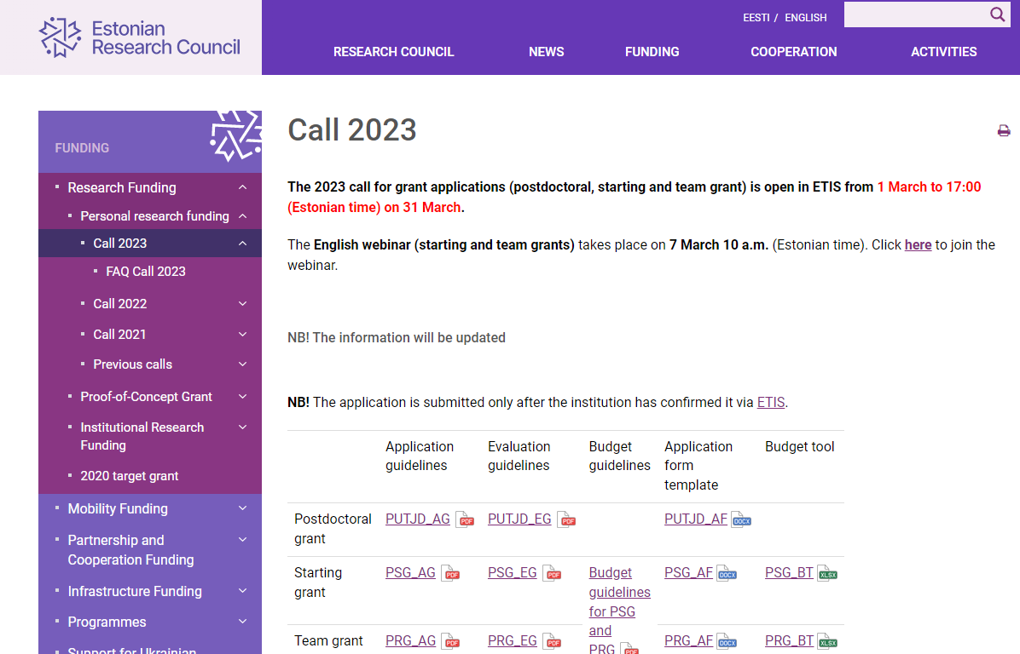
https://etag.ee/en/funding/research-funding/personal-research-funding/psg-prg-call-2023/
Funding -> Research Funding -> Personal research funding -> Call 2023

Slide 4
General principles
The applicant must be the PI of the project.
Grants are for capable researchers from all countries.
For the PI (grant holder), an employment contract with a positively evaluated Estonian R&D institution is obligatory.
PI’s place of work must be Estonia.
Starting grant and team projects have to be implemented in Estonia.
The same person cannot be the PI and the member of the research staff of several grant applications* or projects.
Fixed grant amounts are used.
Notes:
* It is allowed to be member in more than one grant application when the participation periods do not overlap. E.g. In grant application X, the participation periood is 2023-2024, but in grant application Y, the participation period is 2025-2026.

Slide 5
Applicant of the starting grant…
…has received his/her PhD between 1 January 2017–1 January 2022,
…is ready to begin with the project on 1 January 2024,
PS! In case of a later start date, the end date of the project will not be extended. Later date must be applied for by adding an appropriate application to the starting grant application.
… will enter into an employment contract with an Estonian R&D institution on a full-time basis for the duration of the project
…is neither applying for a postdoctoral or team grant nor included as a member of the (senior) research staff in a starting or team grant application,
…whose application has not fallen below the qualification threshold (3 or „Good“) in at least 1 criterion in 2 previous calls (2021, 2022) or has not fallen below „Good“ in at least 2 criteria in the previous call (2022).
Notes:
* In case of a later start date, the end date of the project will not be extended.

Slide 6
Applicant of the starting grant…
…after obtaining the PhD has gained:
a) research experience in a foreign country
OR
b) outside an R&D institution as a researcher at a research-intensive enterprise in the same country
NB! The Evaluation Committee may deem an applicant to meet the requirements if, stemming from the specifics of the research, e.g., in case of healthcare practitioners, it has not been possible to fulfil the aforementioned mobility requirements;

Slide 7
Applicant of the team grant…
…is ready to begin with the project on 1 January 2024*,
… will enter into an employment contract with an Estonian R&D institution on a full-time basis** for the duration of the project and with a place of work in Estonia,
…is neither applying for a starting or another team grant nor included as a member of the research staff in a starting or team grant application,
…does not participate in an ongoing starting grant or team project that will continue in 2024,
…whose application has not fallen below the qualification threshold (3 or „Good“) in at least 1 criterion in 2 previous calls (2021, 2022) or has not fallen below „Good“ in at least 2 criteria in the previous call (2022).
Notes:
* In case of a later start date, the end date of the project will not be extended.
** In justified cases, it is possible to apply for an exception for leading the project while working at the institution on a part-time basis (minimum 0.2).

Slide 8
Fixed Grant Amounts https://etag.ee/wp-content/uploads/2023/02/2023-Budget-Guidelines_puhas.pdf
A grant consists of
direct costs, incl.
staff costs (salaries with taxes, scholarships) (excl. the salary of a doctoral student working as a junior researcher).
research costs (incl. subcontracting costs, costs related to the (open access) publication and popularisation of the R&D results, costs related to the protection of intellectual property, travel costs, costs related to moving to and/or visiting the collaborating institution (in case of PUTJD projects) and other costs that stem from the characteristics of the project);
overhead
Starting and team grants are divided into four different fixed grant amounts (I, II, III, and IV) per year.
NB! Additional conditions have been laid down if applying for the large PSG or PRG grant amount (III or IV).
Notes:
The size of the salary shall be determined by the institution.
The institution is also responsible for keeping an eye on the accounting records of the grant.
Fixed grant amounts (incl. overhead):
PSG I 72,000; PSG II 76,000; PSG III 110,000; PSG IV 117,000;
PRG I 177,200; PRG II 192,400 ; PRG III 249,750; PRG IV 270,000

Slide 9
Team size
Starting grant amounts III and IV can only be applied for when the research team includes at least one member of the senior research staff (in addition to the applicant/PI).
Team grants (I, II) can only be applied for when the team consist of a minimum of three people during the entire period of the team project, including the PI and at least one member of the senior research staff. The third person can be a part of the senior or other research staff.
Team grant amounts III and IV can only be applied for when in addition to the PI, the research team includes at least three members of the senior research staff (workload of at least 0.5 during the entire period of the project)
NB! Names of the people must be shown in the application and the entire project period has to be covered (during the project changes can be made).

Slide 10
In the application…
NB! The application contains automatic checks of technical details. If the application contains an error, the application cannot be confirmed before this error is fixed. Therefore, please give yourself enough time for the confirmation of the application!
The files that can be attached to the justification part of the application as PDF files are as follows:
the list of references;
timetable (e.g., Gantt chart, incl. deliverables and milestones);
risk assessment and mitigation plan and a back-up plan.
figures
Files cannot contain long descriptive text that should be in the justification.
Links cannot be added to the application (this is automatically checked).

Slide 11
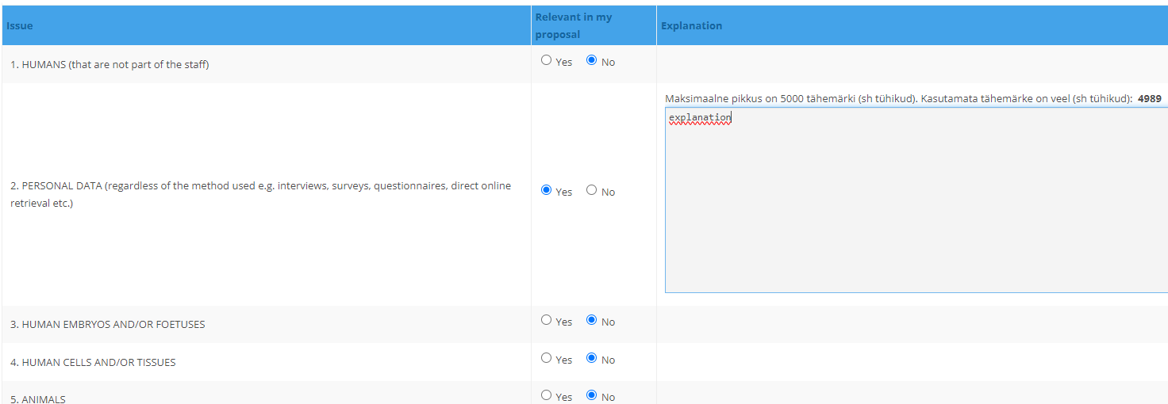
Ethics tab
To fill out the tabel please use the „Guidelines for Completing Your Ethics Self-Assessment for Grant Application„ https://etag.ee/wp-content/uploads/2023/01/Eetika_Tabel_ENG_2023.pdf
Questions concerning ethical issues: Marten Juurik (Head of the Area of Research Integrity, 731 7381).
Notes:
Analyse what ethical aspects the project deals with. Be as detialied as possible and use the guidelines.
Marten Juurik Head of the Area of Research Integrity marten.juurik@etag.ee

Slide 12
Evaluation of PSG and PRG applications
PSG and PRG applications will first be evaluated in 18 Expert Panels that are based on seven research fields (see the list on the website of the Council).
The preliminary final evaluation will be sent to the applicants at the beginning of July (at the latest).
The applicant and the institution are entitled to make objections regarding the preliminary final evaluation (the so-called hearing – deadline 14 August, objections to be sent to etag@etag.ee).
The Evaluation Committee will confirm the final ranking lists of each Expert Panel.
The Evaluation Committee will decide which applications will be forwarded to the Panel on Research Ethics and Data Management considering the position in the ranking list and funding amount.
After the evaluation in the Panel on Research Ethics and Data Management, the Evaluation Committee will make the proposals to approve the applications.

Slide 13
What else is new?
In this call, numerical quality threshold that is different in each field is no longer in use. However, applications with a final score lower than 80% of the maximum score do not qualify for funding.
Research ethics and data management are evaluated in separate criteria using an undifferentiated rating scale („Appropriate“, „Conditionally appropriate“).
Notes:
„Inappropriate“ rating is no longer in use in evaluating research ethics and data management.

Slide 14
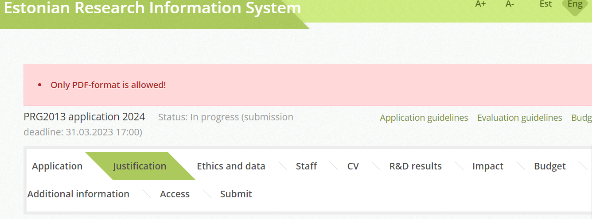

Slide 15
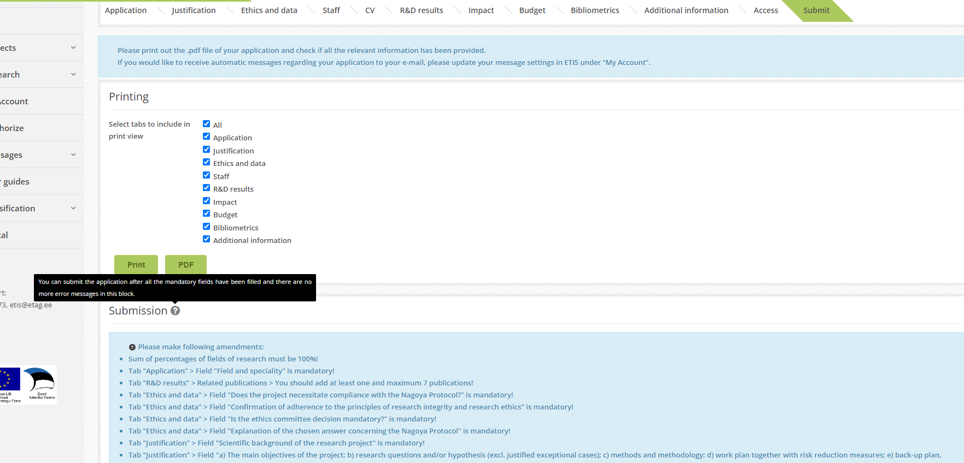
Error messages can be found under the „Submit“ tab
Notes:
You can find the error messages and fields that need to be filled Under the „Submit“ tab.
If you change the expert panel then the application must be refreshed.

Slide 16
Tips for applicants
Read the relevant application guidelines, evaluation guidelines, checklist for applications, and budget guidelines that can be found on the website of the Council. NB! Neither the information on these slides nor in the FAQ section is complete!
If something remains unclear, then please contact the Research Funding Officer of your field.
Compile the application in accordance with the guidelines. Add only the files which are allowed. The limitations on the number of characters apply to all applicants.
All the members of the research staff have to update their ETIS CV.
Make sure that the data of your publications is correct (see the bibliometrics guidelines on the website of the Council).
NB! Please give yourself enough time for the confirmation of the application (consider the auto-check)!

Slide 17
If you have any questions regarding the application
Research Funding Officers:
Medical and Health Sciences; Agricultural and Veterinary Sciences:
Ade Kallas-Kivi (tel 731 7366, ade.kallas-kivi@etag.ee)
Biological and Environmental Sciences:
Meeli Alber(tel 731 7387, meeli.alber@etag.ee)
Exact Sciences:
Raili Torga (tel 731 7358, raili.torga@etag.ee)
Engineering and Technology:
Julia Uusna (tel 731 7367, julia.uusna@etag.ee)
Humanities and the Arts:
Elli Marie Tragel (tel 730 0326, ellimarie.tragel@etag.ee)
Social Sciences:
Eveli Laats (tel 731 7364, eveli.laats@etag.ee)
Head of the Field of National Research Grants:
Helen Post (tel 731 7363, helen.post@etag.ee)
Notes:
If something concerning the procedures at your institution is unclear (regulations concerning the salary, contracts, etc.), then please contact the Research Administration Office/Grant Office of your institution.
If you have any questions regarding the application process or you have some field-specific questions, then please contact the Research Funding Officer of your research field.

Slide 18
Thank you very much for your attention!
If something is unclear do not hesitate to contact us! We are here to help you.
Good luck!

