Slide 1
Euroopa Horisont siseturvalisuse valdkond (kolmas klaster)
Lauri Teppo, ETAg
lauri.teppo@etag.ee

Slide 2
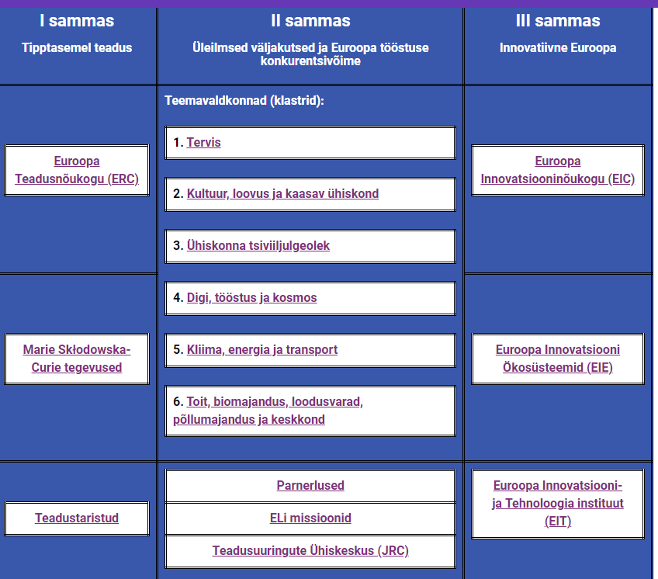

Slide 3
Siseturvalisusest lähemalt- peamised lähtekohad
Siseturvalisus klastri tööprogrammil on neli strateegilist eesmärki:
Ühiskonna paranenud vastupanuvõime õnnetustele;
Inimeste, kaupade ja teenuste vaba ning turvaline liikumine, samaaegselt tõkestades illegaalset tegevust;
Kuritegevuse ja terrorismi tõkestamine, samaageselt väärtustades inimõiguseid ning demokraatiat;
Suurenenud küberturvalisus.

Slide 4
TEEMAVALDKOND „ÜHISKONNA TSIVIILJULGEOLEK“ TEEMAPLOKID
1) Euroopa Liidu ja selle kodanike parem kaitsmine kuritegevuse ja terrorismi eest
2) Euroopa Liidu välispiiride tõhus haldamine
3) Vastupanuvõimeline infrastruktuur
4) Suurenenud küberturvalisus
5) Katastroofidele vastupidav Euroopa ühiskond
6) Tugevdatud julgeolekualased teadusuuringud ja innovatsioon

Slide 5
Kolmas klaster
Umbes 240 edukat taotlust kokku
Aastane eelarve ca 150 M EUR
Hetkel käimas 2023-2024 tööprogrammi teine aasta
2025 aasta tööprogrammi esimene mustand on koostamisel, hetkel puudu veel küberturvalisuse osa. Tõenäoliselt valmib dokument lähema paari nädala jooksul.

Slide 6
Fighting crime and terrorism 2023
HORIZON-CL3-2023-FCT-01-01: Processing of large, complex and unstructured datasets resulting from criminal investigations, while reconciling big data analysis and data protection
HORIZON-CL3-2023-FCT-01-02: A harmonized European forensics approach on drugs analysis
HORIZON-CL3-2023-FCT-01-03: New methods and technologies in service of community policing and transferable best practices
HORIZON-CL3-2023-FCT-01-04: Open Topic
HORIZON-CL3-2023-FCT-01-05: Crime as a service
HORIZON-CL3-2023-FCT-01-06: Enhancing tools and capabilities to fight advanced forms of cyber threats and cyber-dependent crimes

Slide 7
Fighting crime and terrorism 2024
HORIZON-CL3-2024-FCT-01-01: Mitigating new threats and adapting investigation strategies in the era of Internet of Things
HORIZON-CL3-2024-FCT-01-04: Radicalisation and gender
HORIZON-CL3-2024-FCT-01-05: Combating hate speech online and offline
HORIZON-CL3-2024-FCT-01-06: Open Topic
HORIZON-CL3-2024-FCT-01-07: CBRN-E detection capacities in small architecture
HORIZON-CL3-2024-FCT-01-08: Tracing of cryptocurrencies transactions related to criminal purposes

Slide 8
Euroopa Liidu välispiiride tõhus haldamine 2023
HORIZON-CL3-2023-BM-01-01: Capabilities for border surveillance and situational awareness
HORIZON-CL3-2023-BM-01-02: Identify, inspect, neutralise Unexploded Ordnance (UXO) at sea
HORIZON-CL3-2023-BM-01-03: Beyond the state-of-the-art “biometrics on the move” for border checks
HORIZON-CL3-2023-BM-01-04: Interoperability of systems and equipment at tactical level; between equipment and databases; and/or between databases of threats and materials

Slide 9
Euroopa Liidu välispiiride tõhus haldamine 2024
HORIZON-CL3-2024-BM-01-02: Interoperability for border and maritime surveillance and situational awareness
HORIZON-CL3-2024-BM-01-03: Advanced user-friendly, compatible, secure identity and travel document management
HORIZON-CL3-2024-BM-01-04: Integrated risk-based border control that mitigates public security risk, reduces false positives and strengthens privacy
HORIZON-CL3-2024-BM-01-05: Detection and tracking of illegal and trafficked goods

Slide 10
Vastupanuvõimeline infrastruktuur 2023
HORIZON-CL3-2023-INFRA-01-01: Facilitating strategic cooperation to ensure the provision of essential services
HORIZON-CL3-2023-INFRA-01-02: Supporting operators against cyber and non-cyber threats to reinforce the resilience of critical infrastructures

Slide 11
Vastupanuvõimeline infrastruktuur 2024
HORIZON-CL3-2024-INFRA-01-01: Open Topic
HORIZON-CL3-2024-INFRA-01-02: Resilient and secure urban planning and new tools for EU territorial entities
HORIZON-CL3-2024-INFRA-01-03: Advanced real-time data analysis used for infrastructure resilience

Slide 12
Suurenenud küberturvalisus 2023
HORIZON-CL3-2023-CS-01-01: Secure Computing Continuum (IoT, Edge, Cloud, Dataspaces)
HORIZON-CL3-2023-CS-01-02: Privacy-preserving and identity management technologies
HORIZON-CL3-2023-CS-01-03: Security of robust AI systems

Slide 13
Suurenenud küberturvalisus 2024
HORIZON-CL3-2024-CS-01-01: Approaches and tools for security in software and hardware development and assessment
HORIZON-CL3-2024-CS-01-02: Post-quantum cryptography transition

Slide 14
Katastroofidele vastupidav Euroopa ühiskond 2023
HORIZON-CL3-2023-DRS-01-01: Improving social and societal preparedness for disaster response and health emergencies
HORIZON-CL3-2023-DRS-01-02: Design of crisis prevention and preparedness actions in case of digital breakdown (internet, electricity etc.)
HORIZON-CL3-2023-DRS-01-03: Operability and standardisation in response to biological toxin incidents
HORIZON-CL3-2023-DRS-01-04: Internationally coordinated networking of training centres for the validation and testing of CBRN-E tools and technologies in case of incidents, with consideration of human factors
HORIZON-CL3-2023-DRS-01-05: Robotics: Autonomous or semi-autonomous UGV systems to supplement skills for use in hazardous environments
HORIZON-CL3-2023-DRS-01-06: Increased technology solutions, institutional coordination and decision-support systems for first responders of last-kilometer emergency service delivery

Slide 15
Katastroofidele vastupidav Euroopa ühiskond 2024
HORIZON-CL3-2024-DRS-01-01: Prevention, detection, response and mitigation of chemical, biological and radiological threats to agricultural production, feed and food processing, distribution and consumption
HORIZON-CL3-2024-DRS-01-02: Open Topic
HORIZON-CL3-2024-DRS-01-03: Harmonised / Standard protocols for the implementation of alert and impact forecasting systems as well as transnational emergency management in the areas of high-impact weather / climatic and geological disasters
HORIZON-CL3-2024-DRS-01-04: Hi-tech capacities for crisis response and recovery after a natural-technological (NaTech) disaster
HORIZON-CL3-2024-DRS-01-05: Cost-effective sustainable technologies and crisis management strategies for RN large-scale protection of population and infrastructures after a nuclear blast or nuclear facility incident

Slide 16
Tugevdatud julgeolekualased teadusuuringud ja innovatsioon 2024
HORIZON-CL3-2024-SSRI-01-01: Demand-led innovation through public procurement
HORIZON-CL3-2024-SSRI-01-02: Accelerating uptake through open proposals for advanced SME innovation

Slide 17
Edukad projektid
Border management: Using cosmic rays for better, more portable and efficient analysis and detection for customs
Cyber security: An innovative Virtual Reality (VR) based intrusion detection, incident investigation and response approach for enhancing the resilience, security, privacy and accountability of complex and heterogeneo
Fighting crime and terrorism: Gaming Ecosystem as a Multilayered Security Threat

Slide 18
Edukad projektid (2)
Resilient infrastructure: CITYNATURE-BASED SOLUTIONS INTEGRATION TO LOCAL URBAN INFRASTRUCTURE PROTECTION FOR A CLIMATE RESILIENT
Disaster resilient societys: Building PREPAREDness with Collaborative Knowledge Platform, Gamification and Serious Game in Virtual Reality SOCIETY
Strengthened Security Research and Innovation: Engage2innovate – Enhancing security solution design, adoption and impact through effective engagement and social innovation

Slide 19
Eesti osalus
Igal aastal suurusjärgus 40-70 taotlust
Neist 2-9 edukat
1-6 koordinaatorit, ülejäänud parnterid

Slide 20
2024 aasta tööprogramm
Taotlusvoorud lahti juuni- november;
Tulemused reeglina järgneva aasta alguses;
Detailne vaade Funding&Tender (link Etag kodulehel)

Slide 21
Kaasumine
Teadusasutused
Riiklikud institutsioonid
Tööstusettevõtted
Erafirmad
Lõppkasutajad
Rahvusvaheline konsortsium (kas EU või assotsieerunud maad)

Slide 22
Tulevik
Tööprogramm 2025
Raamprogramm 2028 +
Kahetise kasutusega initsiatiiv (dual- use)

Slide 23
Taotluste hindamine
Kolm kategooriat
Excellence
Impact
Quality and efficiency of the implementation
Hindajad üle Euroopa, kõik saavad kandideerida
Eestist möödunud aastal 1 hindaja
Julgustna kandideerima hindajaks

Slide 24
Nädala infokirjad
Iga nädal saadan välja infokirja uuendustega
Lähemad olulised sündmused:
SMI2G 2024, Paris, 22-23.05. Link below. https://www.cmine.eu/events/123953
27.05.2024. EDF brokerage event. https://www.gov.pl/web/ncbr-en/exploring-cooperation-within-european-defence-fund
25-29.05 ISCRAM 2024 “Embracing the Crisis Management Lifecycle”. Link- ISCRAM 2024 “Embracing the Crisis Management Lifecycle” | Events | Crisis Management Innovation Network Europe (CMINE)
28-29.05.2024, European Defense Fund information days. Details can be found: https://defence-industry-space.ec.europa.eu/european-defence-fund-info-days-2024-2024-05-28_en?prefLang=cs#:~:text=The%20event%20will%20take%20place,taste%20of%20what%20to%20expect.
03.06.2024. UNILION (Universities Informal Liaison Offices Network) siseturvalisuse partnerlusüritus. UnILiON Brokerage Event -HE Cluster 3 on Civil security for society calls – Welcome to UnILiON
12-13.06.2024 , cluster 3 info days and brokerage event in Brussels, Register here.

Slide 25
SEREN 5
https://www.seren-project.eu/
Projekt, mis seob erinevate riikide sisejulgeoleku teadusrahastusega seotud isikuid;
Mitmed alamprojektid, kontaktide vahetamine, töötoad

Slide 26
Teave
Kui olete huvitatud liituma siseturvalisuse maililisti/ nädalaste infokirjadega, siis võtke ühendust Lauri Teppoga
Eestikeelne lühiülevaade ETAgi kodulehel
ETAg uudised veebilehel + kalender
HEU osalejaportaal
lauri.teppo@etag.ee
´+372 5259303

Slide 27
Tänan! Ootan Teie küsimusi!

